Slide 1
Jessica McPhaul
Campus Stormwater Project
The Campus Stormwater Project aims to mitigate the effects of stormwater runoff on the university's campus by proposing the installation of water tanks to capture and store rainwater from building downspouts. This water can be reused in systems such as campus cooling or irrigation. Additionally, protecting green spaces and trees is essential, especially with tree buffers established to preserve root zones.
This presentation outlines the GIS exploration stages, from mapping the campus walkways and green spaces to determining the most optimal locations for the stormwater tanks.

Slide 2
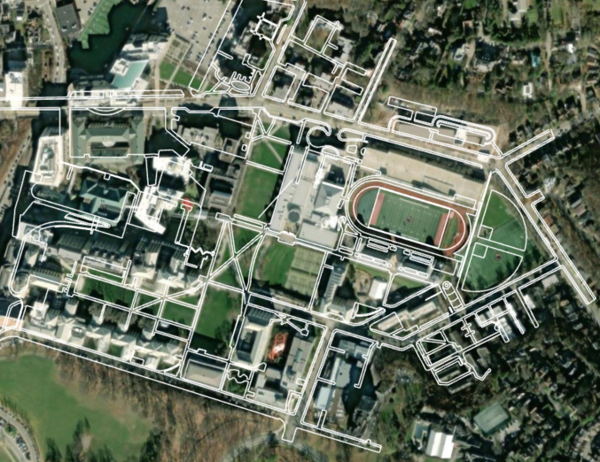
Walkways Mapping
Purpose: Mapping the campus walkways is crucial for understanding the general flow of foot traffic and how construction for the water tanks might affect accessibility.
Methodology: Walkways were digitized based on CAD data and adjusted to align with real-world imagery.
Challenges: Ensuring that the tanks do not disrupt heavily trafficked walkways while maintaining proximity to buildings for stormwater capture.

Slide 3
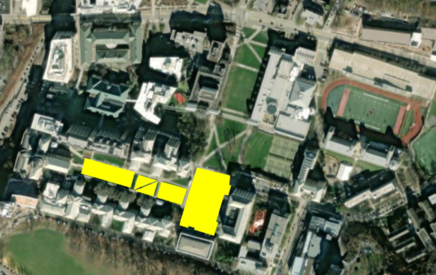
2. Green Areas Digitization
Purpose: Identify and protect green spaces on the campus, which act as natural stormwater absorption areas.
Methodology: Green spaces were digitized using aerial imagery and mapped as polygons.
Challenges: The placement of the tanks must avoid these areas to maintain the campus’s environmental and aesthetic integrity.

Slide 4
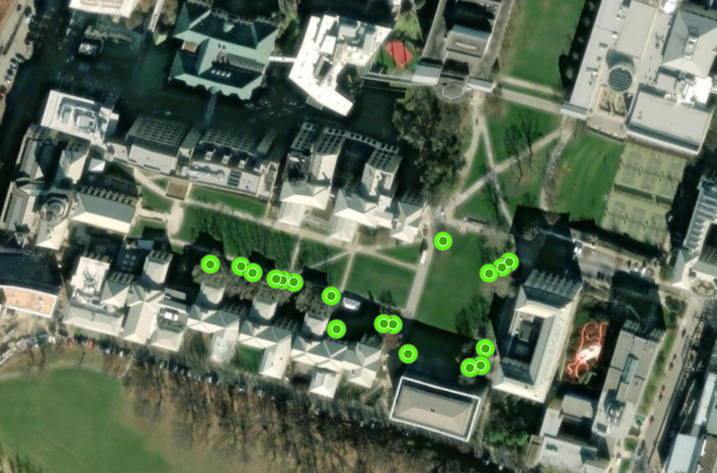
3. Tree Buffer Mapping
Purpose: To protect trees during the construction of the water tanks, a 30-foot buffer was established around each tree to ensure their roots are not disturbed.
Methodology: Trees were digitized as point features, and a buffer was generated around each tree to safeguard root zones.
Challenges: Tank placement had to avoid overlapping with these buffers to ensure minimal impact on tree health.

Slide 5
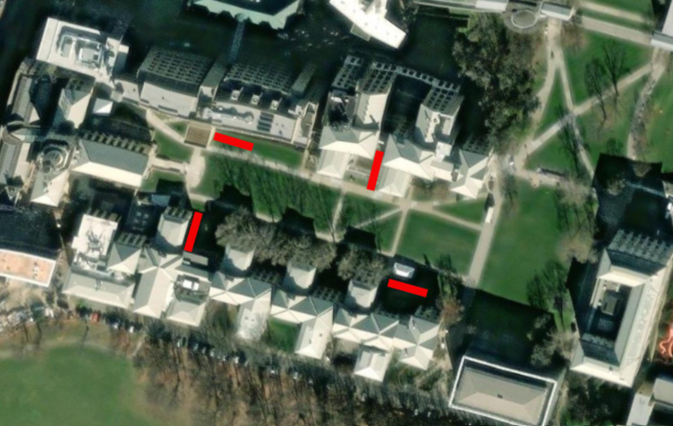
4. Water Tank Placement
Proposed Tank Locations: Water tanks are strategically placed adjacent to buildings, ensuring proximity to downspouts and drainage systems to capture stormwater effectively.
Tanks were carefully positioned to avoid interfering with walkways, tree buffers, and green spaces.
Alternative Locations: Should construction constraints arise, alternative tank locations could be further along the peripheral areas, where they would still capture runoff but have less direct impact on central campus spaces.
Logic Behind the Placement:
Building Proximity: Tanks are placed near the downspouts of buildings to capture rainwater runoff efficiently.
Avoiding Tree Buffers: The 30-foot buffers around tree trunks were maintained to avoid disrupting tree roots, ensuring the long-term health of the campus's vegetation.
Maintaining Accessibility: Walkways are kept clear of any obstructions to maintain ease of access for students and staff across the campus.

Slide 6


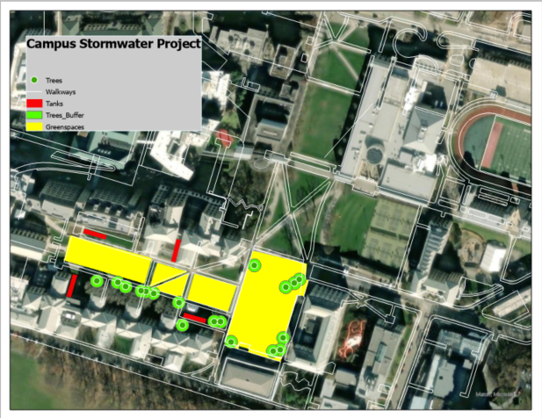
Conclusion
The proposed locations for the water tanks optimize stormwater capture while minimizing the environmental and logistical impacts on the campus. These locations ensure that the tanks do not interfere with important green spaces, walkways, or tree roots, making the project both effective and sustainable.

